Slide 1

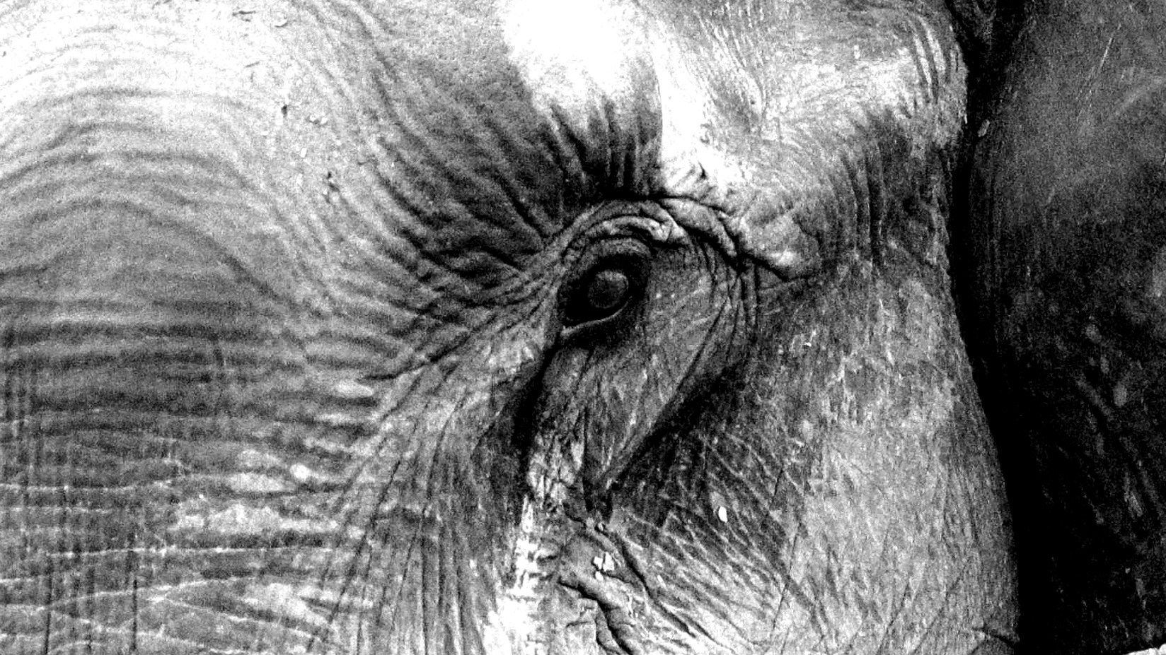
7600
GARDE FAMILY OFFICE
Your Trusted Partner for Family Office Design
The International Family Office Summit
The Forum Embassy Hill
21 May 2025
Opening
Shaun Slabber
Sponsor
Who is in the reporting or firing line, and how do we report and communicate? Trends, changes, and preferences.

Slide 2
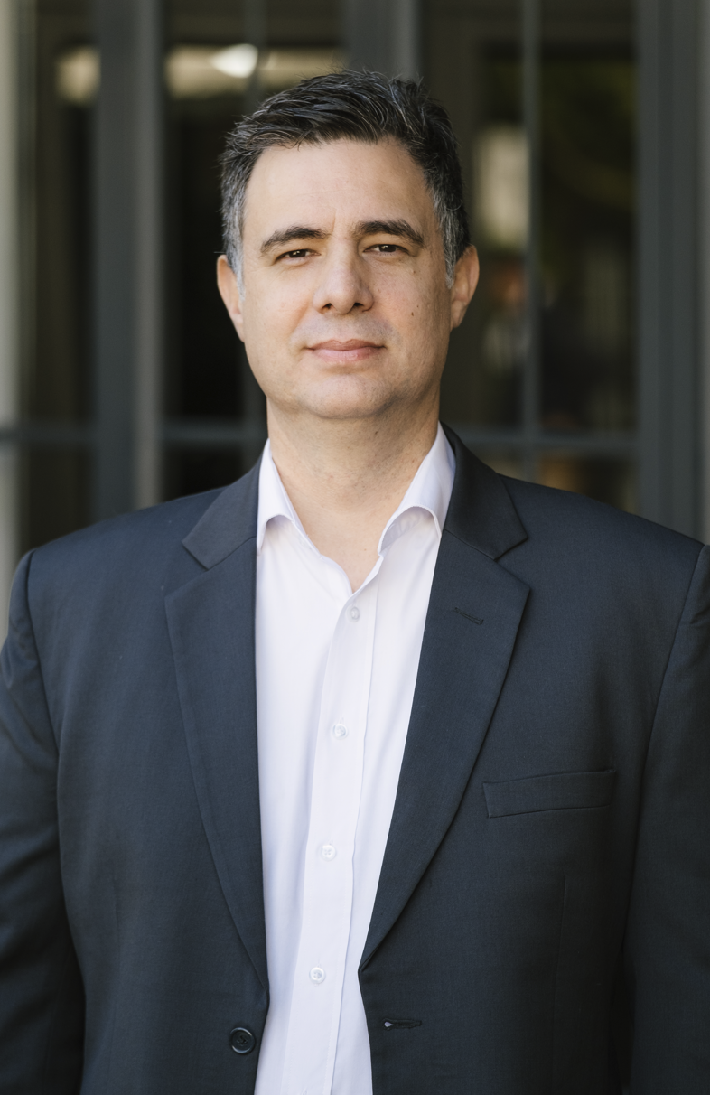
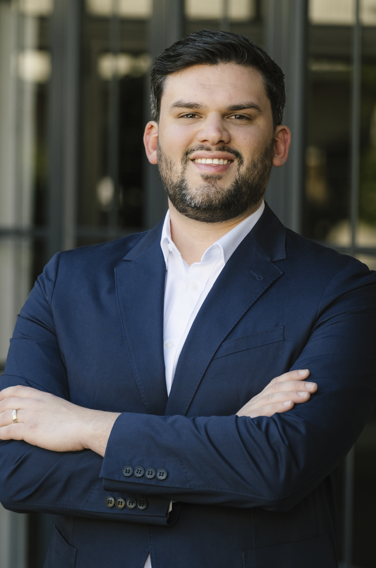
Introduction
Garde Capital is a boutique Family Office Management firm, providing bespoke solutions and structures, based in Stellenbosch, South Africa.
We offer holistic solutions to families and corporates on comprehensive estate planning, corporate structuring and trust administration to safeguard inter-generational legacies.
A well structured family office framework is essential for affluent families
Discover how Garde Capital can tailor a family office framework to safeguard and enhance your family’s wealth
Shaun Slabber
Charl du Plessis

Slide 3
Why choose Garde Capital
FAMILY OFFICE SOLUTIONS
EXPERT ADVICE
INVESTMENT SOLUTIONS
LENDING SOLUTIONS
SUCCESSION PLANNING
LEGACY CUSTODIANS
Access to Garde Capital’s network of experts across various fields.
21 years of experience, across a diverse Family Office client base, ensures a network of experts across every field you can think of.
Customised for the family and their needs that fits their legacy structure requirements.
Access to Private Equity deals and Private Bankers globally.
Garde Capital has a network of institutions that could consider supporting certain ventures that the family is considering.
Garde Capital ensures that the Family Office Framework of Constitution designed by the family is actioned accordingly, while the baton is changing hands between generations.
Whilst drafting the framework all the elements of a champion succession plan are put in place along the way

Slide 4

Our Global Reach and Experience
Australia
Bermuda
British Virgin Islands
Canada
Cayman Islands
Cyprus
Dubai
Guernsey
Hong Kong
Hungary
Ireland
Jersey
Malta
Mauritius
Namibia
Netherlands
Seychelles
Singapore
South Africa
Switzerland
USA
  Atlanta
  Miami
Zambia

Slide 5



Who is in the reporting or firing line, and how do we report and communicate? Trends, changes, and preferences.
Family offices encounter several challenges, including talent retention, succession planning, and adapting to technological advancements.
The answer varies depending on several realities.
Talent Retention
Attracting and retaining skilled professionals who understand the complexities of family wealth management can be a significant challenge.
Succession Planning
Ensuring smooth leadership transitions across generations is a common challenge faced by family offices.
Technology Adaptation
Family offices must stay current with evolving technologies, including artificial intelligence and cybersecurity measures.
Service Expansion
As family dynamics change, offices must scale their services while maintaining high quality.

Slide 6
Who is in the reporting or firing line, and how do we report and communicate? Trends, changes, and preferences.
Governance and communication
As family members continue to hold executive and C-suite positions, establishing effective governance structures, including family protocols and maintaining clear communication channels, remains critical.
It is an ongoing challenge to find the right structure and communication strategy that are crucial to managing expectations and mitigating potential conflicts.

Slide 7
Who is in the reporting or firing line, and how do we report and communicate? Trends, changes, and preferences.
  Operational challenges facing the modern family office, which impact who gets hired, fired, or what the preferences are, for example
  .Increased accounting and reporting complexity
  .Data security
  Generational changes
A structured framework fosters long-term financial sustainability.

Slide 8
Who is in the reporting or firing line, and how do we report and communicate? Trends, changes, and preferences.
Navigating
Navigating an uncertain economic environment;
remaining nimble.
Implementing
Implementing AI – not without its challenges and risks.

Slide 9
Who is in the reporting or firing line, and how do we report and communicate? Trends, changes, and preferences.
Generational differences can cause friction, but also create opportunities
For example, the younger generation will demand more focus on impact investing,

Slide 10
Who is in the reporting or firing line, and how do we report and communicate? Trends, changes, and preferences.
Geopolitical situation
Arguably harder to define is the responsibility of monitoring economic conditions, market trends, and other factors, which can significantly impact how they behave and the decisions they make, both globally and locally.
Like the previous challenge, families have international ties and face complex cross-border tax and legal issues.
The complexity adds more pressure, risks, and stress

Slide 11
Preparing the Next Generation
Becoming good board members
Where does their journey start?
Becoming board members
Specific education or training requirements
At what level and where in the organization?
What should Next Gen do?

Slide 12


Multi Family Office Advantages
Customization with Cost Efficiency: High net worth families benefit from tailored solutions without the exorbitant costs of establishing an in-house team or single-family office.
Expertise and Diverse Offerings: Specialized professionals offer a wealth of knowledge and a wider range of investment opportunities, enhancing financial management and growth potential. Multi-family offices have access to a number of different advisors as a result of their diverse client base.
Family Governance and Dispute Resolution: Multi-family offices assist in maintaining family unity and addressing conflicts, which is particularly crucial for preserving wealth across generations.
Accounting and Reporting using a skilled team of Professionals
Tax optimisation and legal frameworks built into the Trust Deeds
Professional Oversight: High net worth families can enjoy oversight from experienced professionals while focusing on their core strengths and personal pursuits.
Technology required for Family Office Management is already in place
Privacy Considerations: Trusted multi-family offices prioritize client confidentiality, addressing privacy concerns effectively.
In conclusion, the multi-family office setup strikes a balance between customization, expertise, cost-efficiency, and family harmony. For high net worth families seeking comprehensive financial management, a multi-family office offers a practical solution that leverages collective strengths while addressing potential drawbacks.

Slide 13
Designing a Legacy
Family Office Framework and Family Constitution Development.
Questions to assist you
Family Background
Provide a brief overview of your family history, values, and culture.
Family Objectives and Vision
What are your family’s short-term and long-term financial objectives?
Family Governance
Key Family Members
Wealth Holdings
Family Values and Principles
Decision-Making and Conflict Resolution
Describe the main source of family wealth and assets
What is the vision for your family’s wealth and legacy over generations?
Have you established any family governance structures or processes? (e.g. Family meetings, councils)
If yes, please provide details.
If no, would you be interested in implementing?
List the names and roles of key family members involved in the wealth management and decision making.
Describe the responsibilities and areas of expertise.
Provide an overview of your family’s wealth holdings, including assets, businesses, investments, and real estate.
Include approximate values and percentage of total wealth for each category
What are the core values and principles that you would like to see reflected in the family constitution?
Are there any specific family traditions or values that are important to preserve?
How are major financial decisions currently made within the family?
How does the family handle conflicts or disputes related to wealth and assets?
This questionnaire covers various aspects of a family's financial situation, values, governance, and goals, providing essential information for Garde Capital to assist in the development of a family constitution and family office framework.

Slide 14
Designing a Legacy
Family Office Framework and Family Constitution.
Questions to assist you – continued
Please outline your expectations for moving forward in developing a family constitution and family office framework.
Philanthropic Goals
Legal and Financial Documents
Family Education
Family Office Framework
Additional Information
Next Steps
Wealth Transfer and Succession
Are there plans in place for wealth transfer to the next generation?
What are your expectations for succession within the family, especially concerning family businesses?
Does your family engage in philanthropic activities?
If yes, please describe your philanthropic goals and initiatives.
Do you have existing wills, trusts, or other estate planning documents?
Please provide a summary of these documents, including the names of trustees and beneficiaries
Are there efforts to educate family members about wealth management and governance?
How can Garde Capital assist in educating family members?
Are you interested in developing a family office framework to manage your wealth comprehensively?
What specific services or areas of wealth management would you like to address within the framework?
Is there any other information or considerations you would like to share with Garde Capital?
This questionnaire covers various aspects of a family's financial situation, values, governance, and goals, providing essential information for Garde Capital to assist in the development of a family constitution and family office framework.

Slide 15
Contact us
SHAUN SLABBER:
shaun@gardecapital.co.za
+27 (0) 84 948 4649
CHARL DU PLESSIS:
charl@gardecapital.co.za
+27(0)82 782 4641
Source material
10 key challenges for family offices in 2024 - Citco
Five operational challenges facing the modern family office
ADDRESS:
Office 11, The Woodmill,
Stellenbosch, Western Cape,
South Africa
7600
OFFICE HOURS:
Mon-Fri : 8:00-17:00

