Slide 1
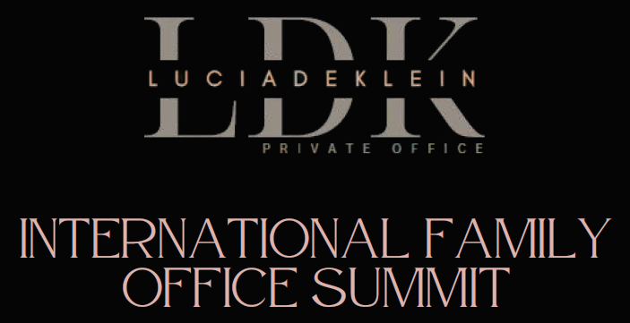
Let your legacy live on

Slide 2


Mathys Briers-Louw
BComm (Law), LLB (Stellenbosch)
LLM in Transnational Business Practice (Pacific, McGeorge, USA & Bucerius, Germany)
Attorney
mathys@sllaw.co.za
+27 82 493 99 31

Slide 3


TAX
LEGAL
FIDUCIARY
EXCHANGE CONTROL
APPROPRIATE STRUCTURING
www.situs360.com

Slide 4
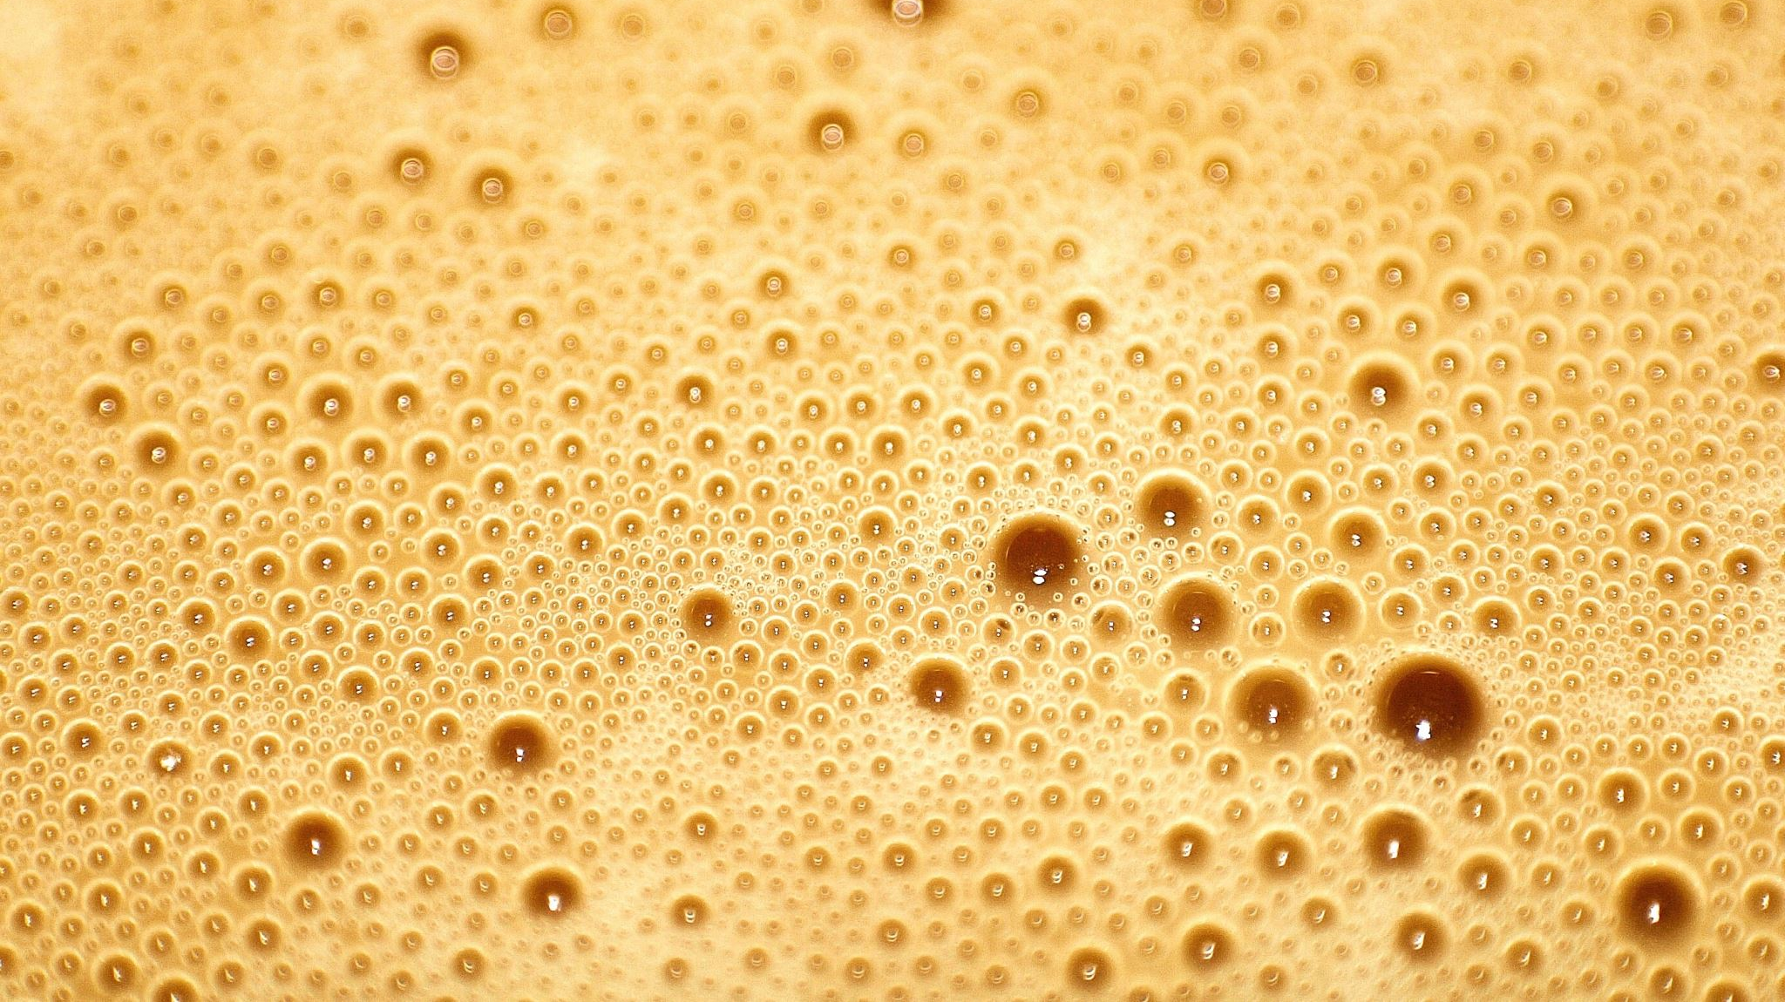
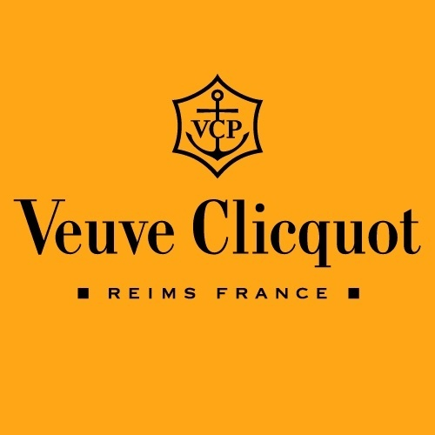
The story of Veuve Clicquot is one of resilience, innovation and transformation in the world of champagne.

Slide 5
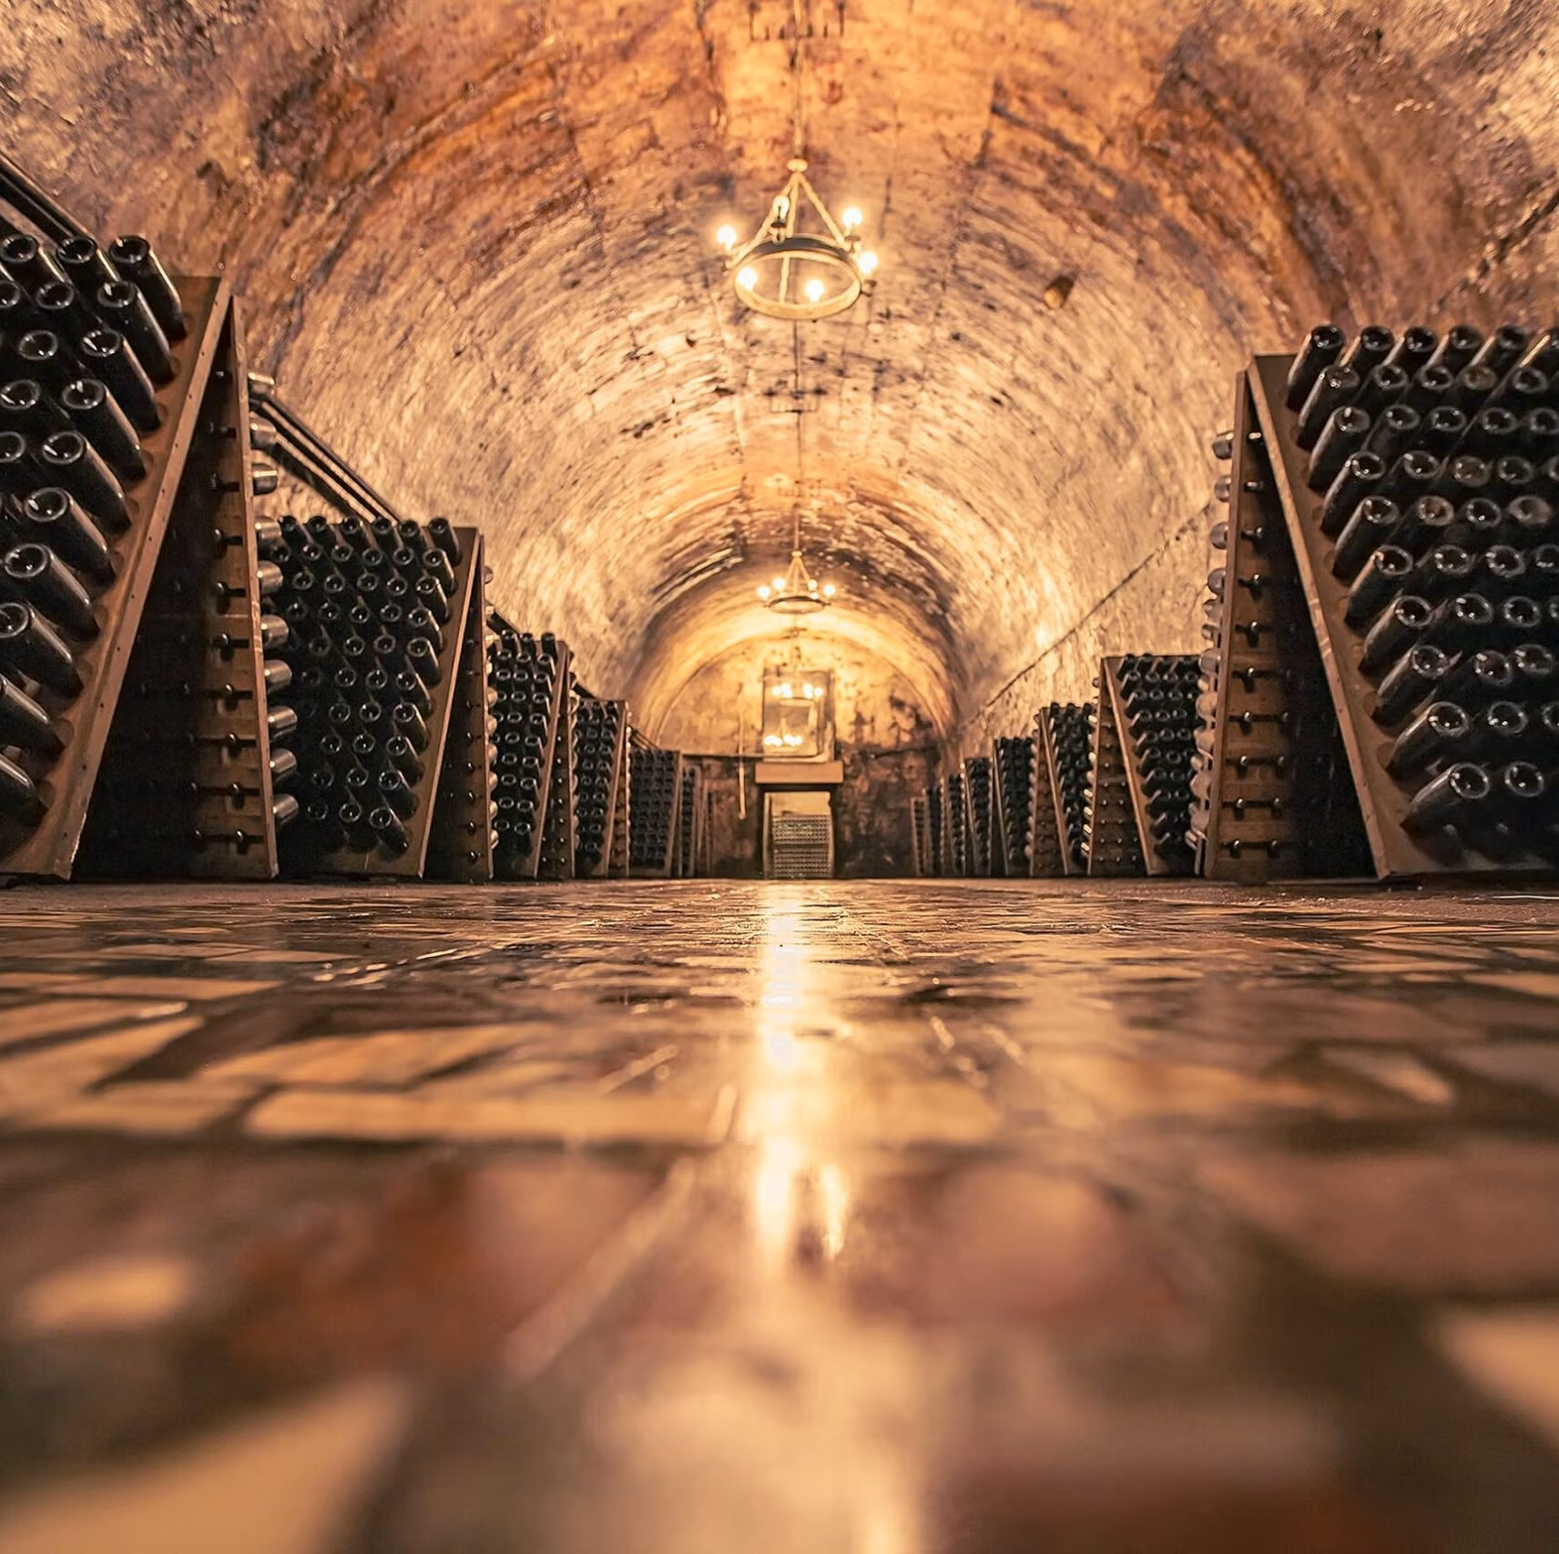
The Origin
(Veuve Clicquot)
Founded in 1772 in Reims, France
By Philippe Clicquot, a textile merchant who decided to start a wine business.

Slide 6
Veuve Clicquot
Her name was Barbe-Nicole Clicquot Ponsardin.
Just 27 years old.
Recently widowed.
Society expected her to mourn, remarry, and fade quietly into the background.
She had other plans…

Slide 7
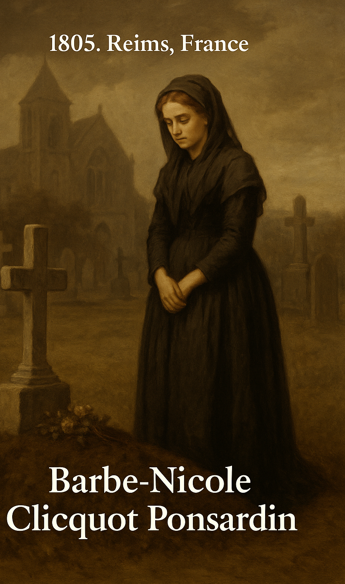
The Widow Clicquot (Veuve Clicquot)
“In a world where women had no seat at the table… one woman dared to take the whole table, and pour champagne over it.”

Slide 8
Veuve Clicquot
Despite the conventions of the time, which discouraged women from running businesses, Barbe-Nicole took over the company, becoming one of the first female entrepreneurs of the modern era.

Slide 9
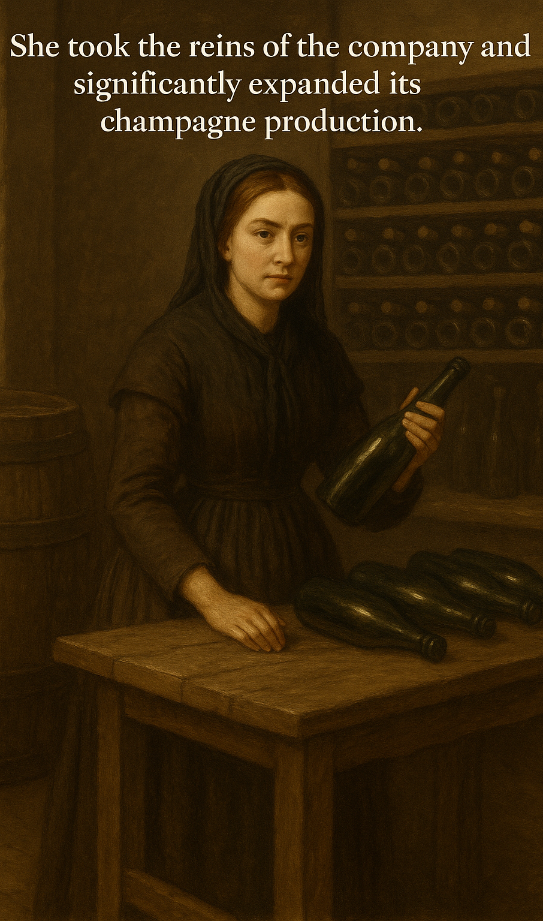
The Rise
Armed with grit and guided by instinct, she took over the family champagne business, something unheard of for a woman in Napoleon’s France.
But she was not content with making ordinary wine.
She wanted clarity, quality, and elegance in every bottle.
She invents the riddling rack, turning bottles upside down, gently rotating them, so the sediment slides into the neck. Her wine? Suddenly crystal clear, like sunlight in a flute.

Slide 10
The Rise
Word spreads. Bottles are smuggled across war-torn Europe.
In Russia, the Tsar himself tastes her champagne and declares:
“I drink this… and I drink nothing else.”

Slide 11
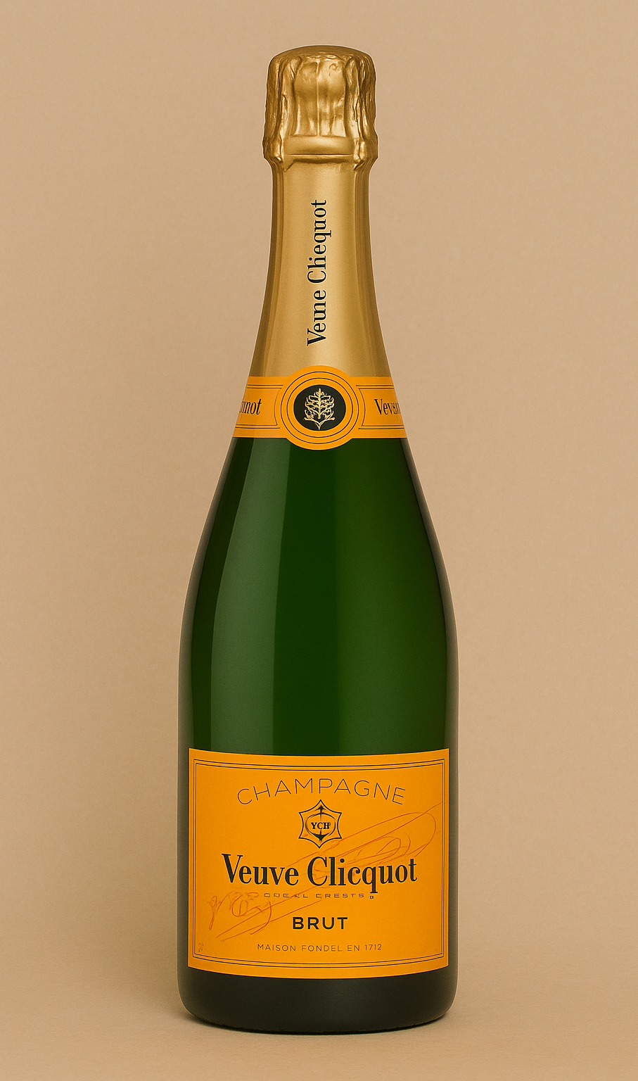
The Legend
Through war, economic collapse, and prejudice, the widow built an empire from the bubbles of her sorrow.
And she did it with a single guiding principle:
“Only one quality – the finest”

Slide 12
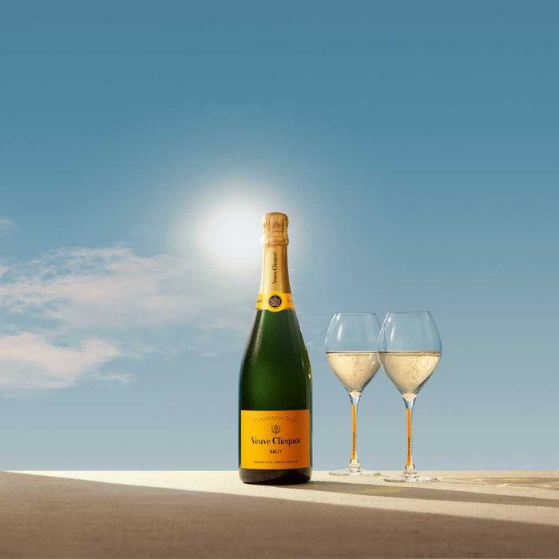
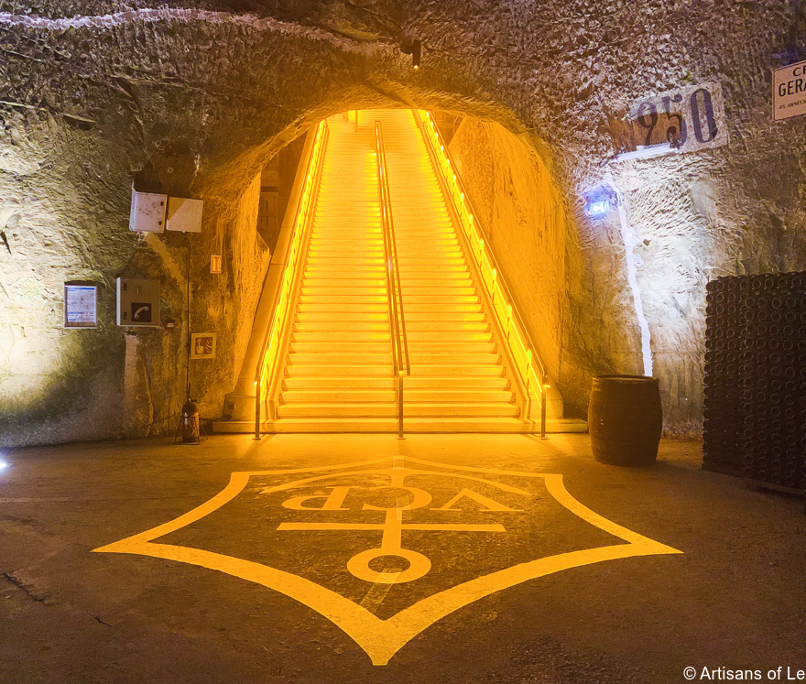
Today
Every bottle of Veuve Clicquot still bears her name and the cap her face.
Not just as a brand, but as a legacy.
Not of loss.
Not of mourning.
BUT of audacity, elegance, and innovation.

Slide 13
The Story of Madame Bollinger:
The Lady Behind Bollinger Champagne
Lily Bollinger’s leadership began under extraordinary circumstances. In 1941, after her husband’s death, she assumed control of the house during World War II, a period marked by Nazi occupation and severe shortages of labour and resources.
Lily Bollinger’s story is part of a broader legacy of widows who shaped the Champagne industry at a time when women’s rights were severely restricted. By remaining unmarried after her husband’s death, she retained control of the business and her independence, thereby paving the way for future generations of women in the wine industry.
In 1961, she launched the R.D. cuvée, ageing Champagne much longer on its lees and disgorging it just before sale. This technique preserved freshness and complexity, and the bottles were the first in Champagne to display the disgorgement date - a significant innovation in the industry.

Slide 14
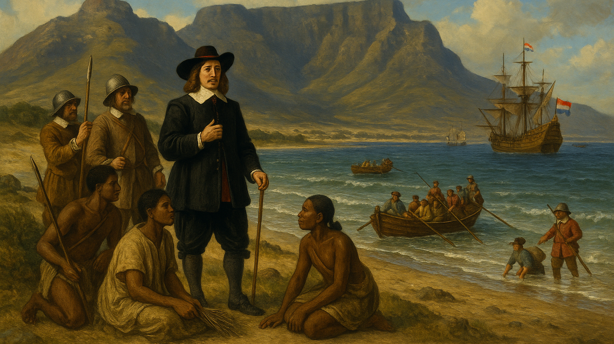
1652

Slide 15
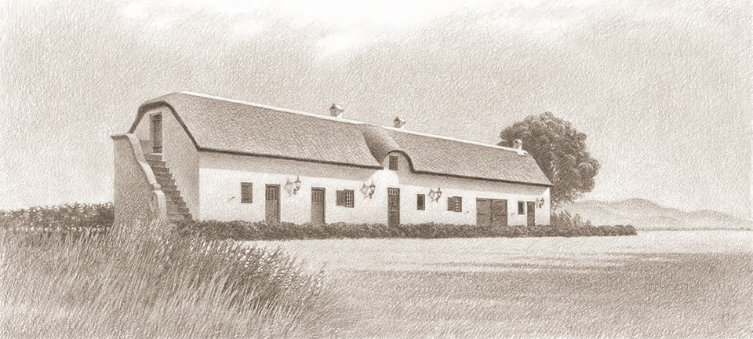
It is the year 1693…
41 years after Jan v Riebeeck arrived in the Cape

Slide 16

Eenzaamheid is situated in the Agter-Paarl area of South Africa’s Western Cape province. The name of the farm is Dutch for “solitude”, and refers to its isolation from Cape Town, when it was named in 1693.

Slide 17
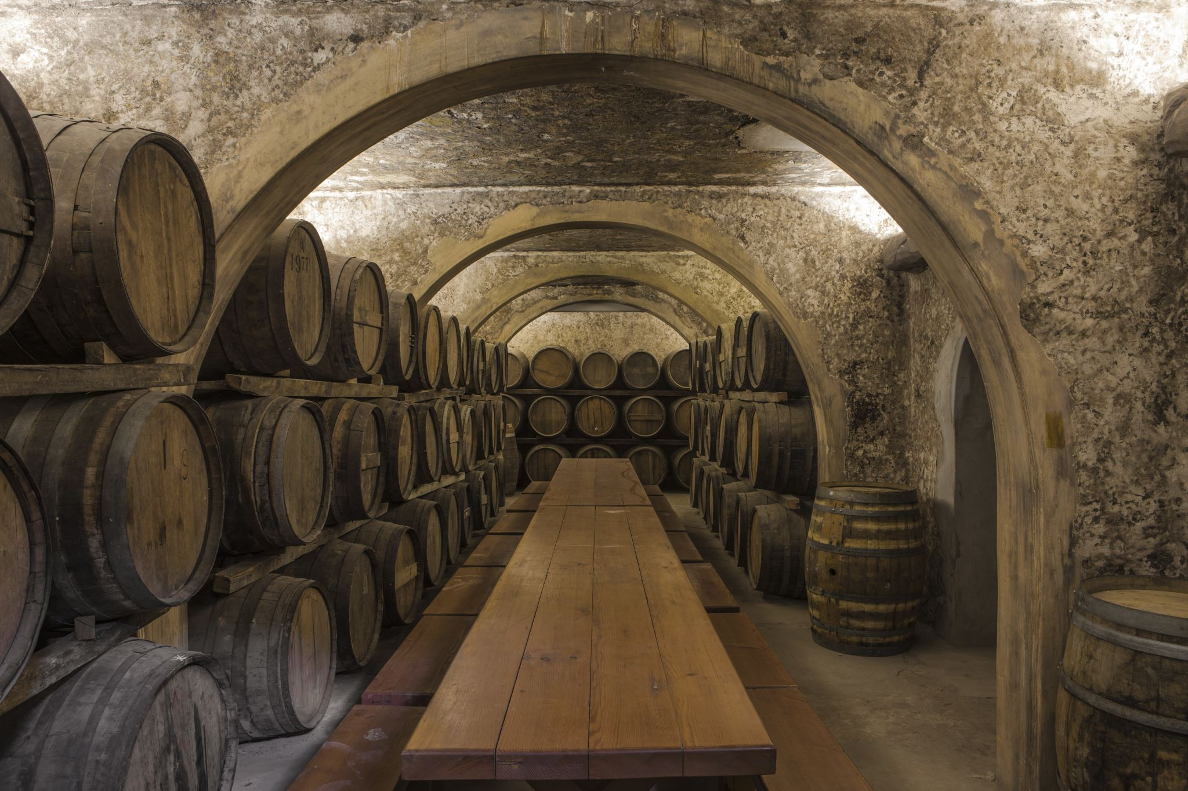
History
In 1693, Claas Dippenauw became the first owner of what was then a 60-morgen farm and called it Eenzaamheid.
After his death in 1715, his widow, Sara Tas, inherited Eenzaamheid and later sold it to her brother, Adam Tas.

Slide 18
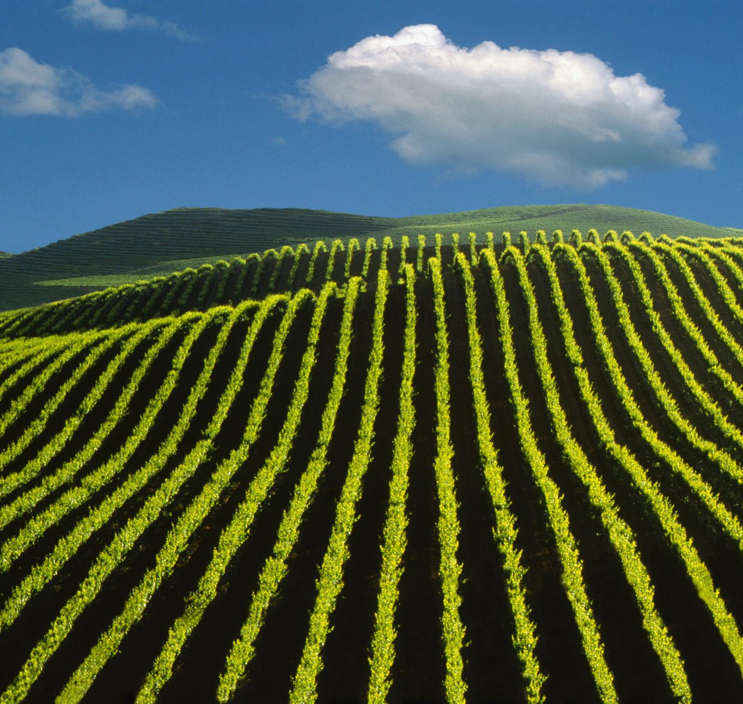
History
In 1722, Philip Morkel bought Eenzaamheid from Adam Tas’s estate and when he passed away, his widow, Katharina Pasman, inherited the farm.
Their daughter, Sofia, married Johannes Albertus Myburgh and they acquired Eenzaamheid in 1764 for an amount of 6000 Gulden.
Johannes and Sofia’s son, Phillipus Albertus Myburgh, inherited Eenzaamheid, and when he passed away, his widow, Helena inherited the farm.
In 1826 a new foreman named Pieter Franciscus Melchior Briers arrived at Eenzaamheid, and in the same year he married his new employer’s daughter, Hester Myburgh. In 1869 one of their descendants, CJ Briers, married Helena Josina Myburgh.

Slide 19
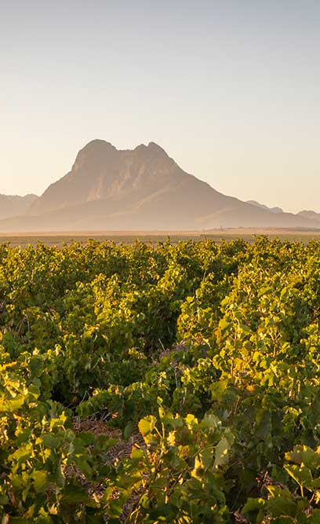
Women's Envied Inheritance Rights
A significant moment in the family’s lineage occurred when Engela Hendrienna Briers, a descendant of the farm's early custodians, married Jan Nicolaas Louw, who had worked as a foreman on the farm.
This union of the Briers and Louw families cemented a generational legacy, although it was uniquely governed by a testamentary condition that preserved the Briers family name, hence the combined surname Briers-Louw. This ensured the continuation of the Briers heritage through their descendants while integrating the Louw family’s contribution to the farm’s development.

Slide 20
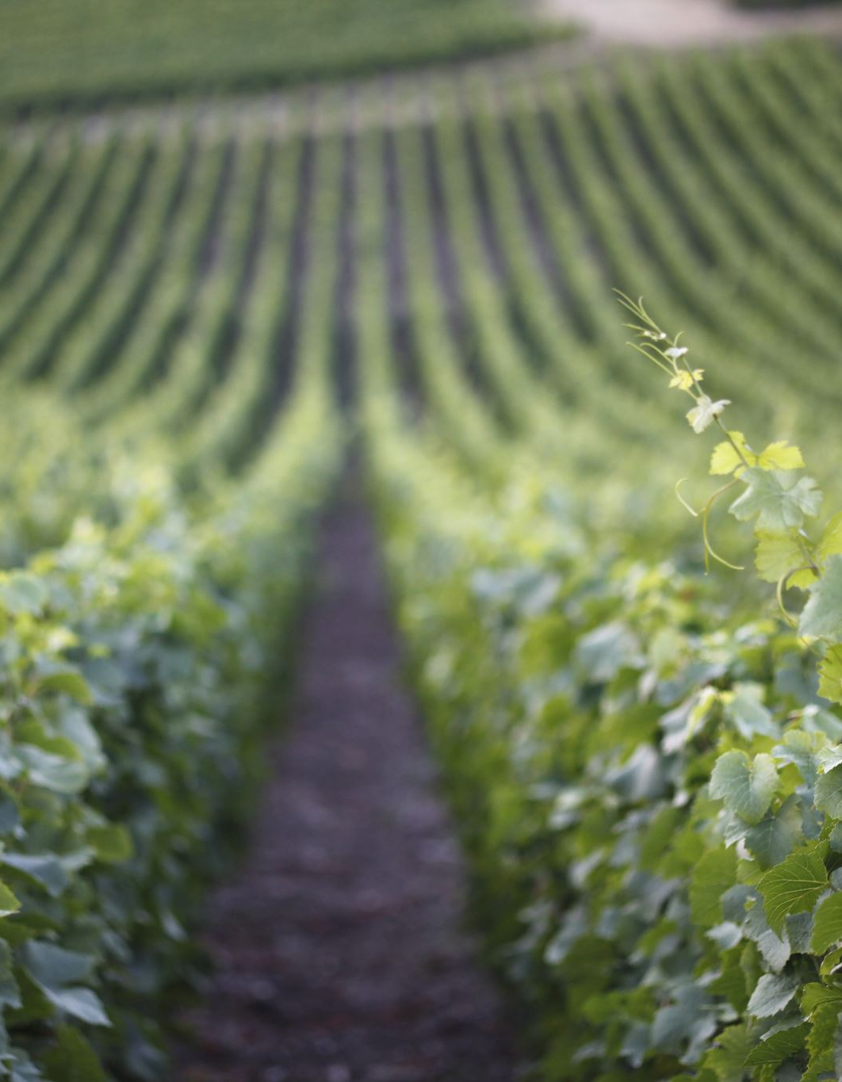
Eenzaamheid Today
Eenzaamheid continues to produce wines of exceptional quality and character.
Their offerings reflect the integrity of the vineyard, the dedication of the Briers-Louw family, and the serene solitude that inspired the farm’s name centuries ago.
Visitors to the estate are treated to more than just fine wines, they are invited into a story that spans generations, filled with resilience, family bonds, and a passion for the land.

Slide 21
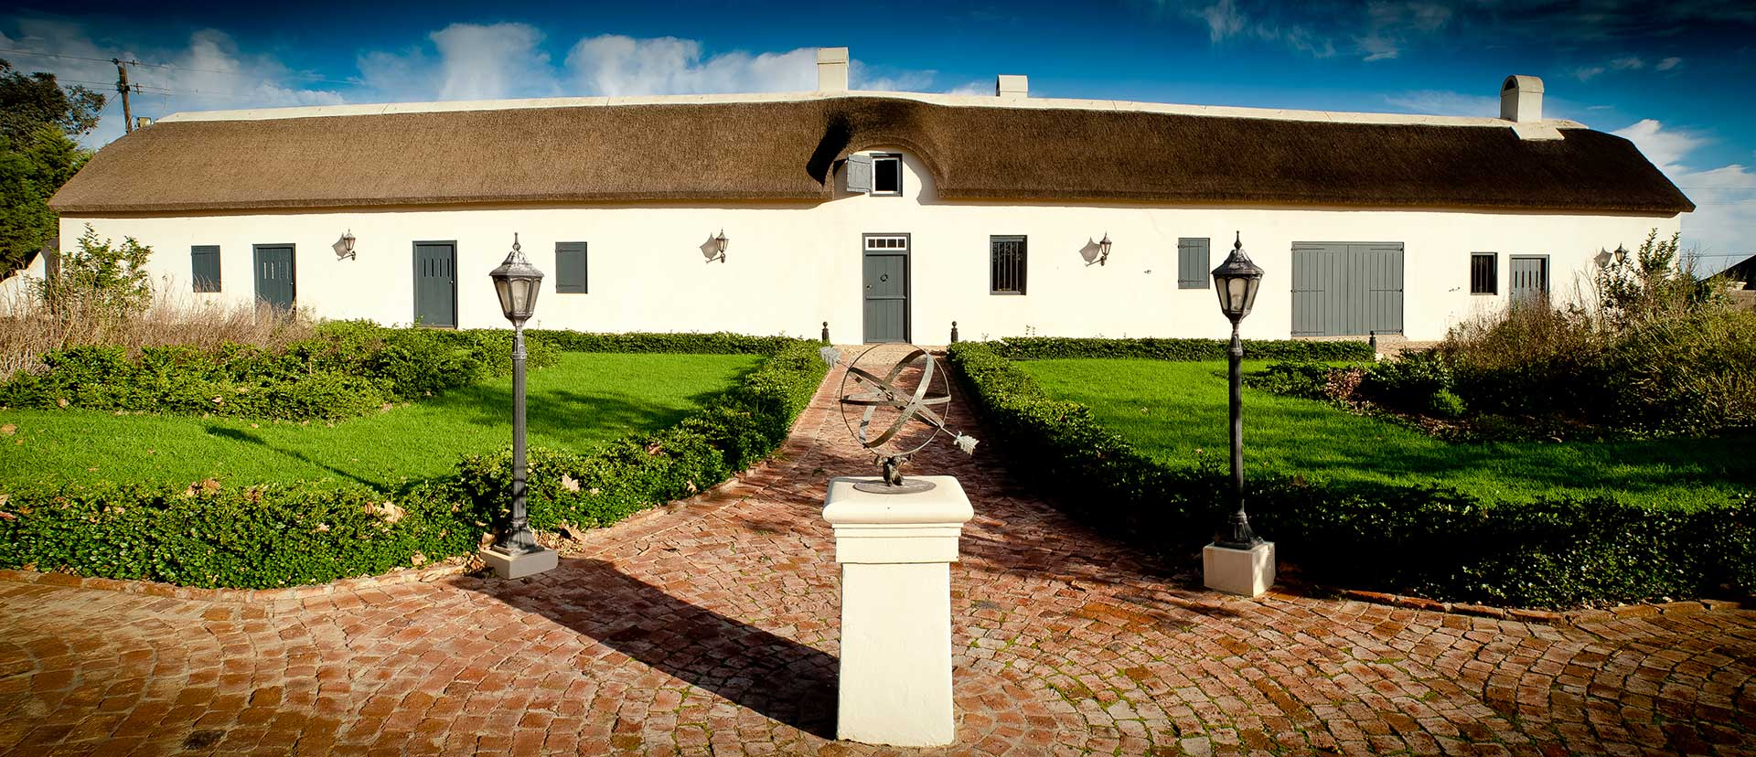
Eenzaamheid Farm is more than 330 years old

Slide 22
The original farmstead, which still exists today, was built before Eenzaamheid was granted in 1693. This building was constructed in the same era as the Castle of Good Hope and is known as a “pioneer dwelling” with its distinctive wolf-nose gable.
It is 40m long and 4.5m wide and was used partly as a homestead and partly as a shed. These buildings were normally built to knee-height from local stone, followed by layers of homemade bricks of clay and straw.

Slide 23
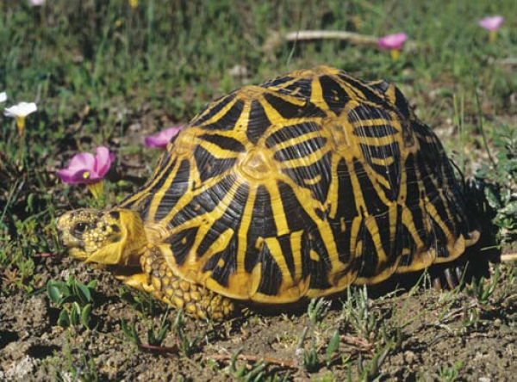
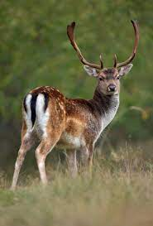
The farmhouse on Eenzaamheid is indeed one of the oldest “pioniershuisies” (pioneer dwellings) in SA.
The farm itself was named and granted in 1693, but evidence suggests the original farmstead was constructed even earlier, before the official grant, placing its origins around 1690. This makes it contemporaneous with the earliest European settlement period in the Western Cape.
Established in 1972, the JN Briers-Louw Nature Reserve, situated on the farm, is under the stewardship of CapeNature and provides a valuable respite for the little tortoise that is under so much pressure due to loss of habitat and predation.
“Another treat, as we drove from the gates of the reserve, was when fallow deer were pointed out that quickly dispersed as our vehicle approached.”

Slide 24
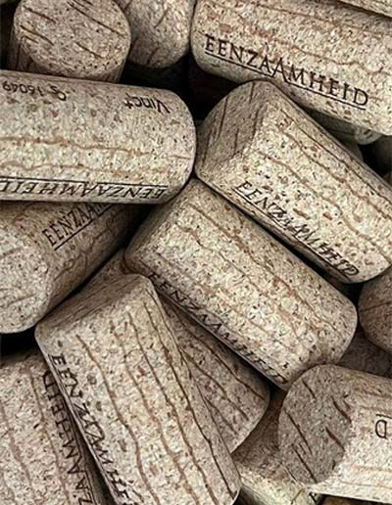
Corporate Social Responsibility
CSR is a self-regulating business model by which companies make a concerted effort to operate in ways that enhance rather than degrade society and the environment in the pursuit of social accountability to itself, its stakeholders, and the public.
improved reputation for brand image,
enhanced employee engagement,
morale retention,
increased customer loyalty, and
financial outcomes

Slide 25
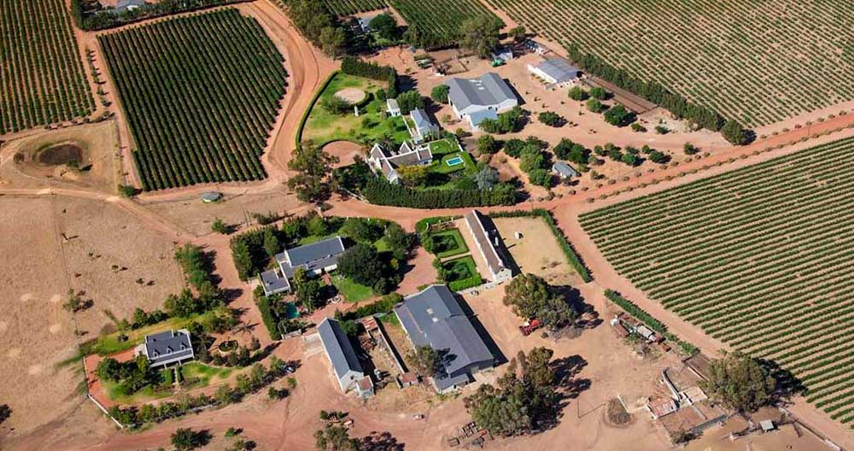
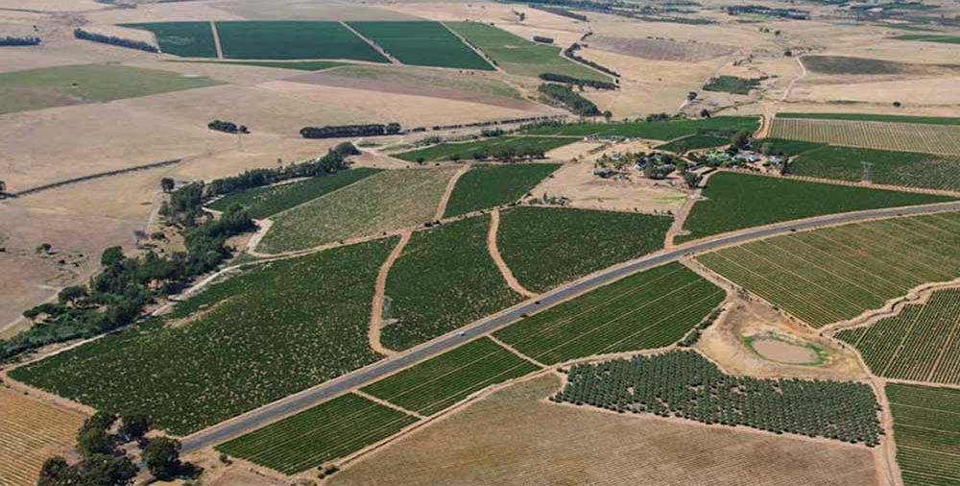
The Briers-Louw family have been the capable custodians of this beautiful property for over 190 years and have developed the farm into a multi-faceted enterprise including grapes, cattle, sheep, wheat and hospitality.

Slide 26
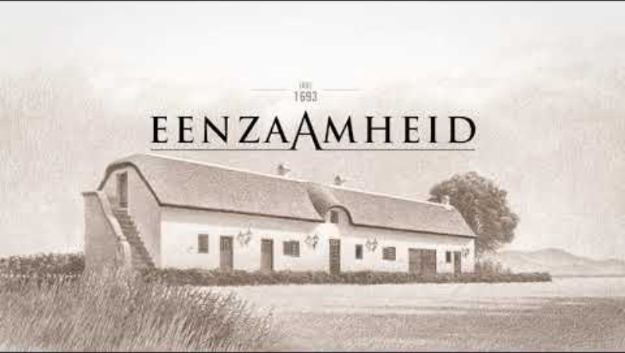

Slide 27
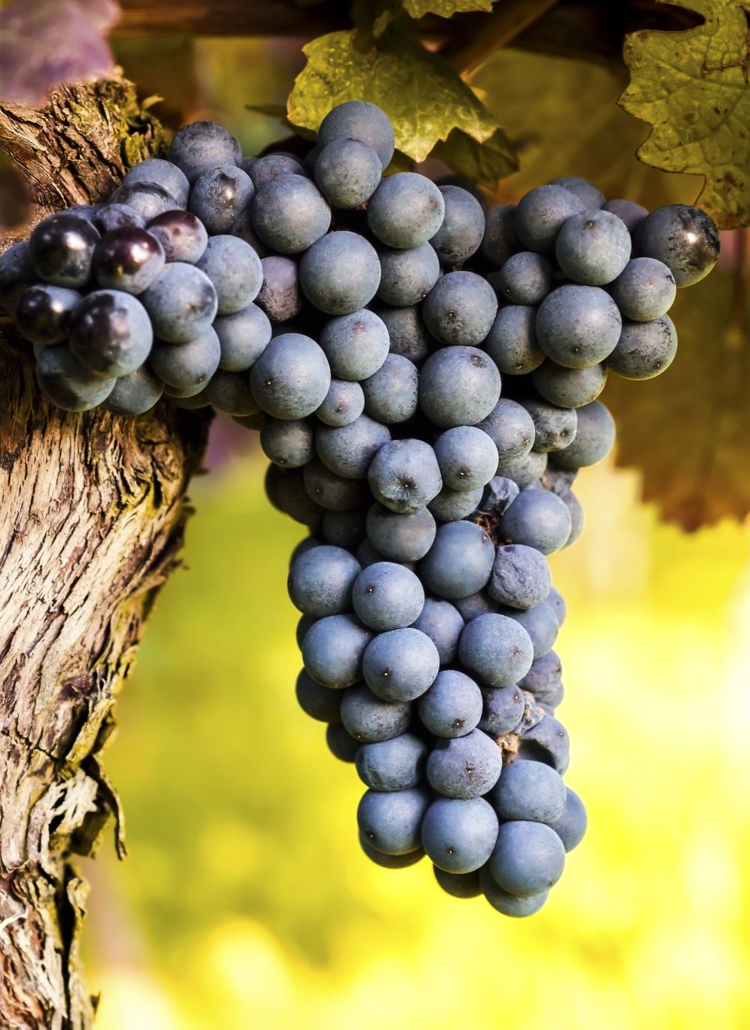
Generations of commitment
Seven generations of my family have tended dryland vines, with knowledge and skills inherited from one generation to another.
The Mediterranean climate and deep shale soils of Paarl are reflected in the unique character of my family’s fine and distinctive wines. Each bottle is hand-crafted by traditional methods for your enjoyment.
Cheers to good health, peace and prosperity!

Slide 28
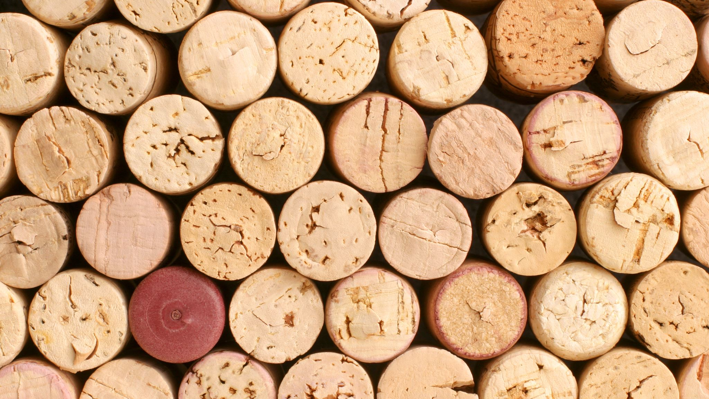
THANK YOU

